Slide 1







Public Health Emergency Operations Centre
(PHEOC)
Malaysia Capacity in Managing COVID-19
Dr. Badrul Hisham Abdul Samad
Distinguished Fellow &
Consultant Public Health Physician
Faculty of Medicine & Defence Health
National Defence University of Malaysia

Slide 2
Outline of Presentation
Incident Command System (ICS)
Incident Management System (IMS)
IMS Structure & Functions
PHEOC Operational Modes
Incident Action Plan (IAP)
Interface with Other EOCs
Malaysia PHEOC Key Facts in COVID-19 Response

Slide 3
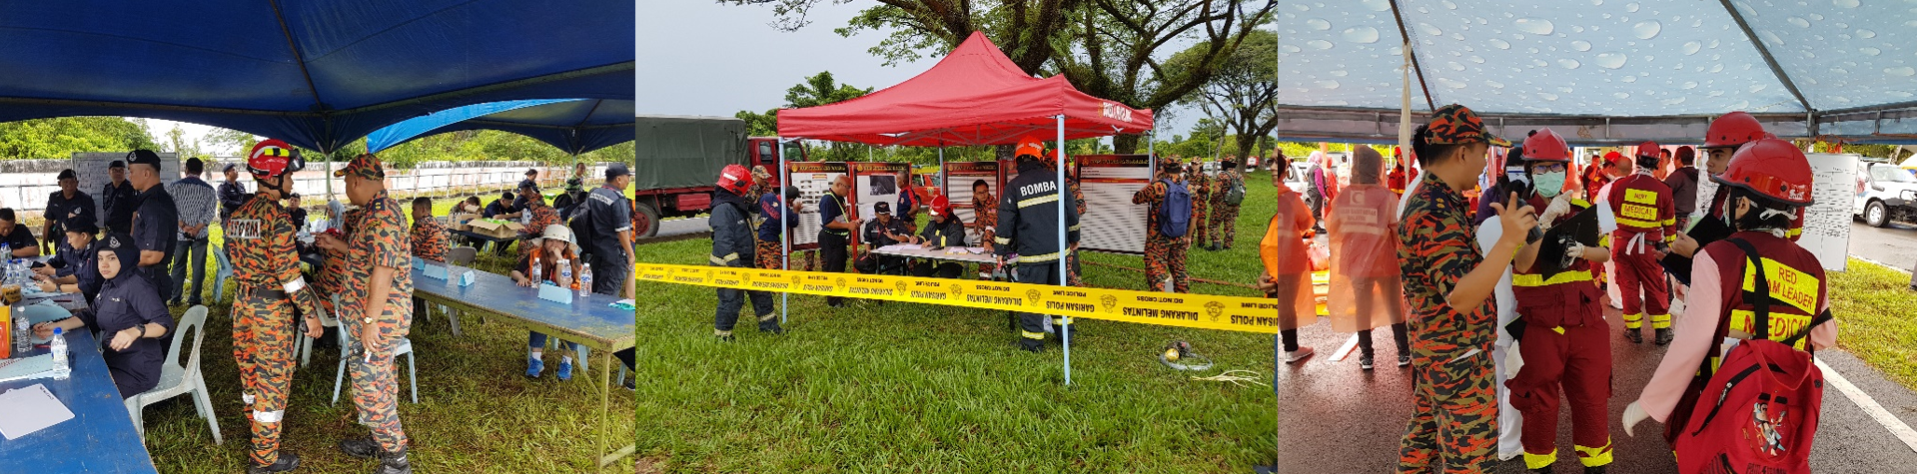
Incident Command System (ICS)
The Incident Command System (ICS) is a standardised approach to the command, control, and coordination of emergency response whereby responders from multiple agencies are put under unified command
ICS consists of a standard management hierarchy and procedures for managing incident(s) of any size

Slide 4
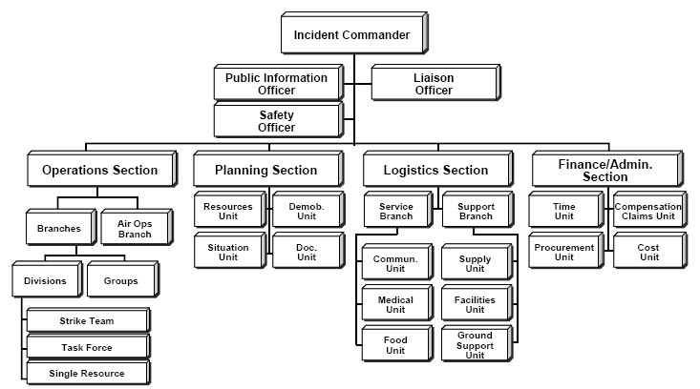
ICS is flexible and scalable in modular form applied in the field

Slide 5

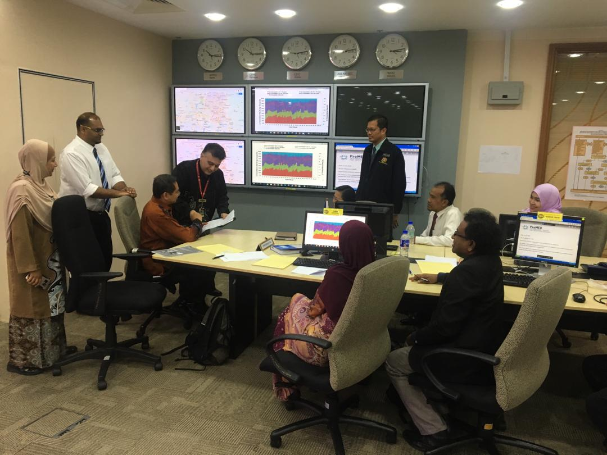
PHEOC Framework
Incident Management System
IMS
National Crisis Preparedness & Response Centre (CPRC), MOH Malaysia
IMS is applied at district / state / national level

Slide 6
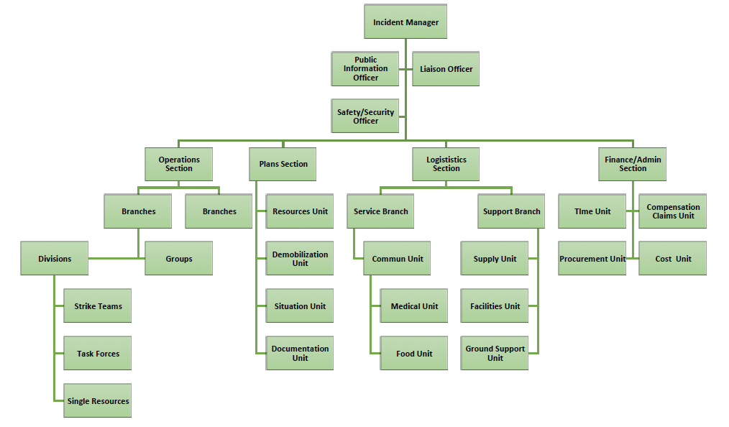
Incident Management System
IMS
IMS is flexible and scalable in modular form

Slide 7
Incident Management System (IMS) Structure & Functions
Management: An executive, strategic, operational, command and coordination
function – making decisions and coordinating.
Planning: Responsible for evaluation of the situation (information gathering and analysis), predict evolution/progress of the emergency, assessment of the options and keeping track of resources.
Operations: Supporting tactical application of resources (establishes tactics / strategies and directs operational resources to achieve incident response objectives). Responsible for using resources to respond directly to the event.
Logistics: Acquiring and deploying resources – procurement, distribution, maintenance, replacement and repatriation of material and human resources including provision of support infrastructure and services to response staff.
Finance and Administration: tracking expenditure, payments, administrative services.

Slide 8


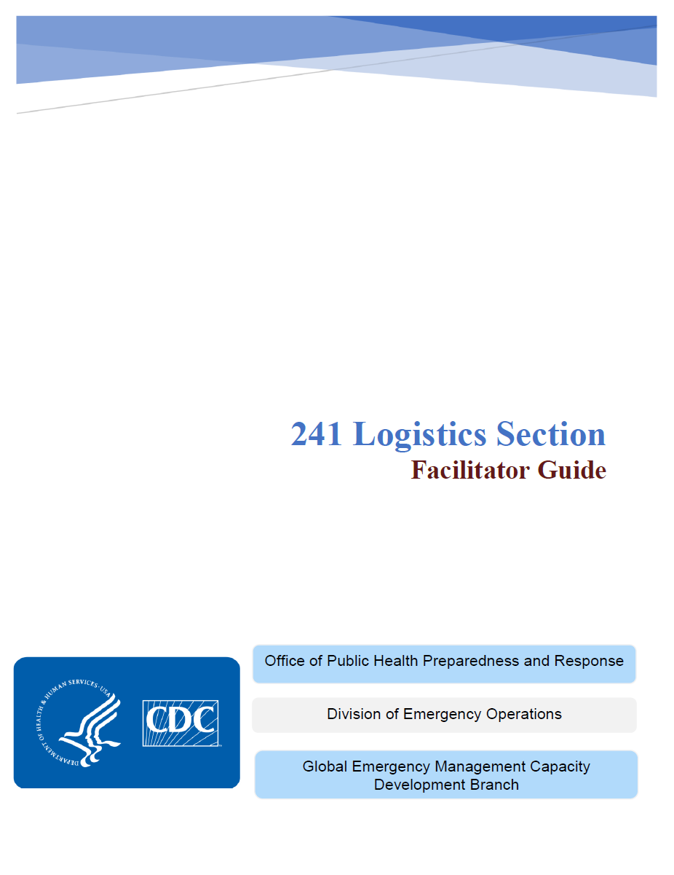

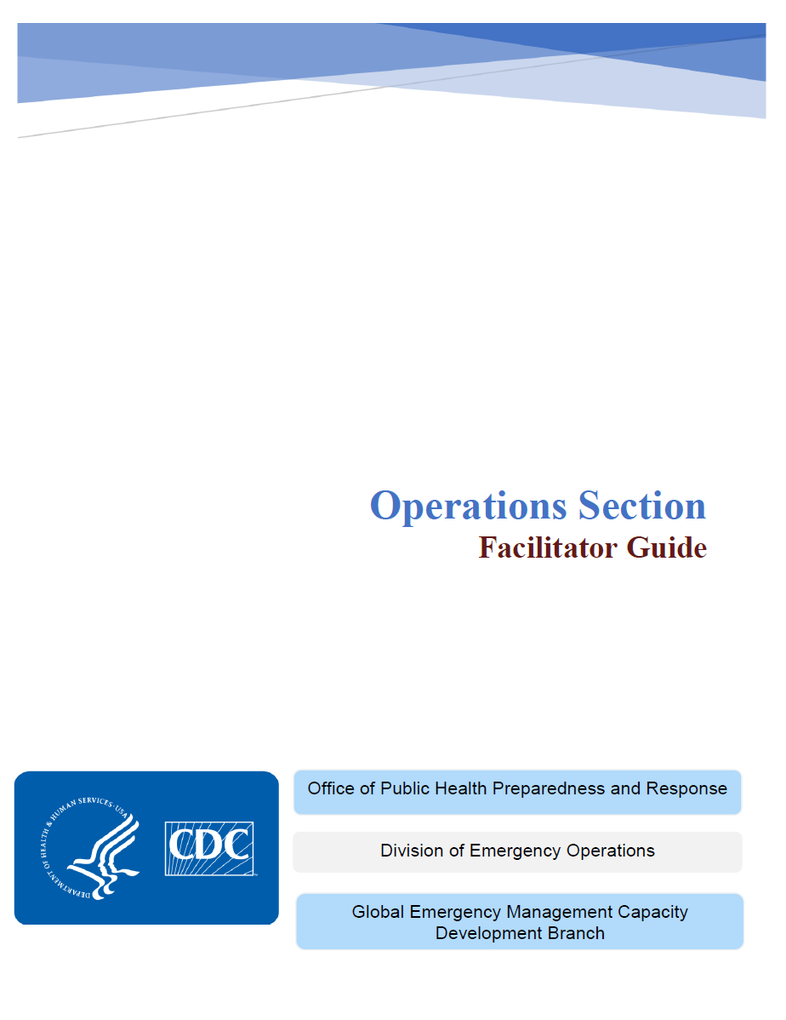


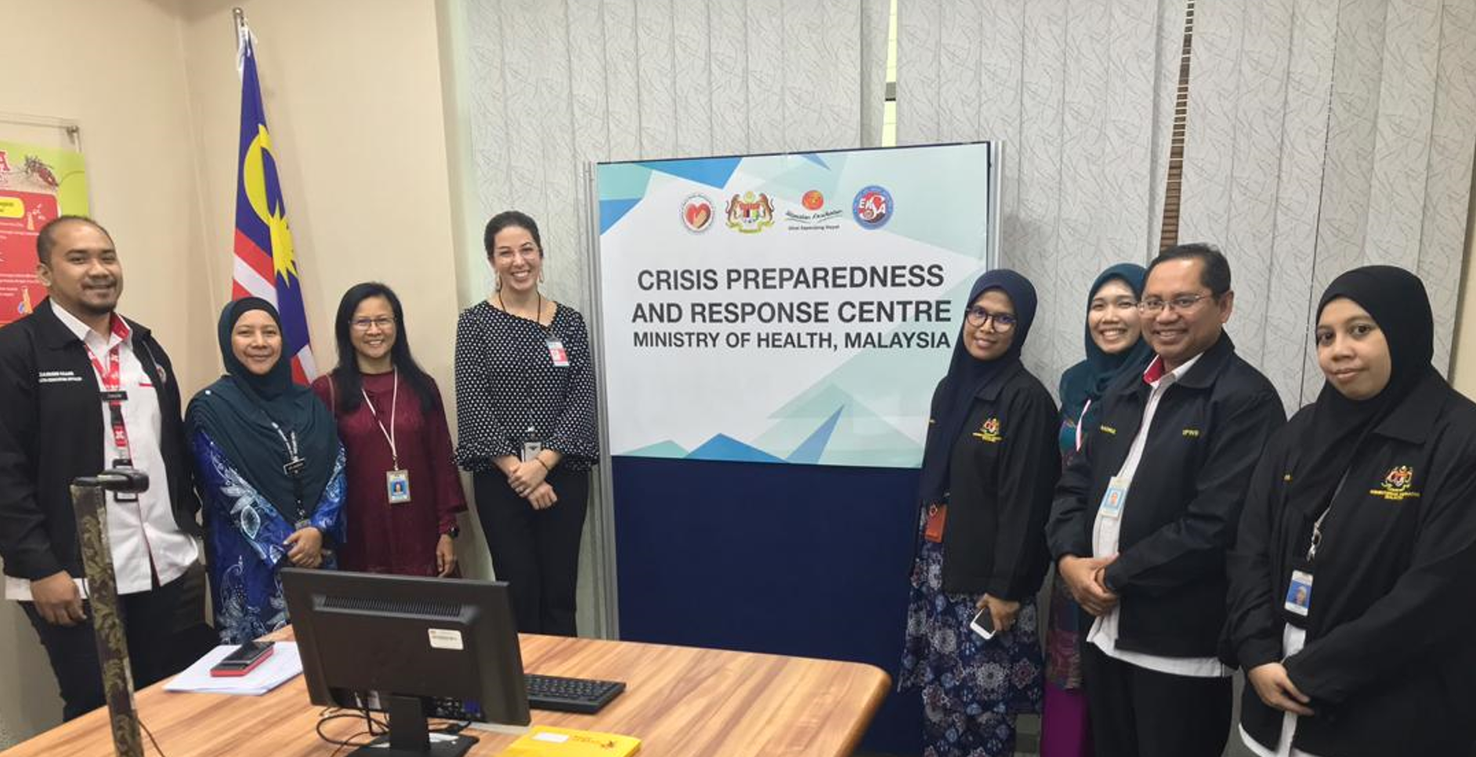

Slide 9
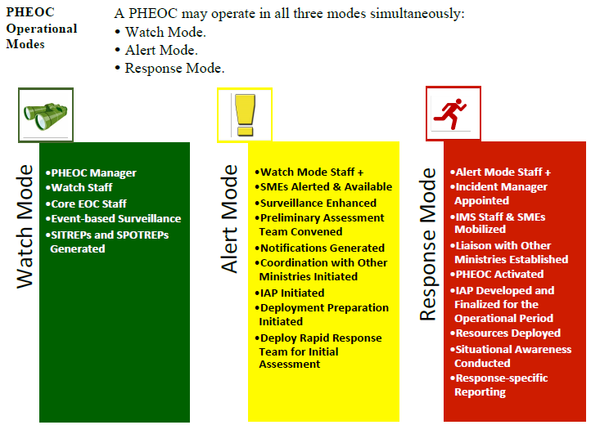
PHEOC
Operational
Modes

Slide 10
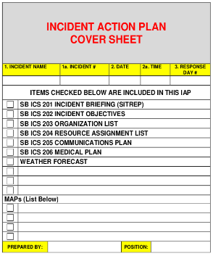
Incident Action Plan (IAP)
Based on assessment of the scale and impact of the public health emergency and the availability of resources and capacities, action plans result in a more effective response. A written or oral incident action plan describes the specific objectives that must be accomplished in succession in order to achieve larger event management goals.
Incident action plans are developed within the planning section, and provide all PHEOC supervisory personnel with directions for current and future actions. Incident action plans also form the basis for defining operational periods. Operational periods reflect the time required to achieve specific objectives identified in the action plan, and to plan in advance for required resources.
The purpose of the IAP is to:
Ensure common goals among response personnel
Provide direction for actions
Provide means of communication of incident objectives
Ensure a coordinated response
IAP

Slide 11
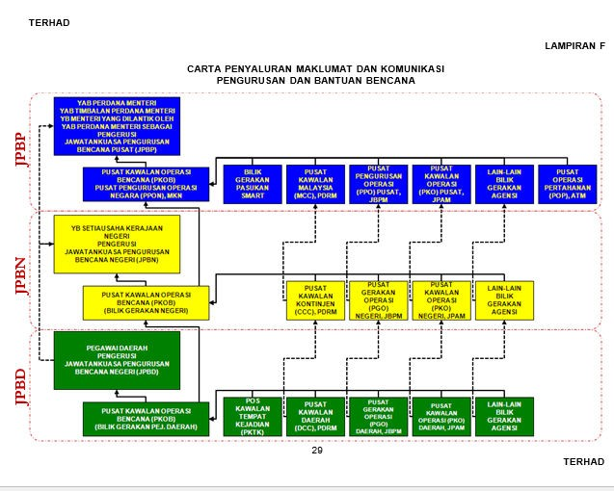
NATIONAL DISASTER COMMUNICATION, MANAGEMENT
Interface with Other EOCs
AND ASSISTANCE
Other Agencies Operation Rooms including MOH Malaysia (CPRC)
Coordination at National level
National Crisis/Disaster event: National Disaster Management Agency (NADMA)
Security event: National Security Council (NSC)

Slide 12
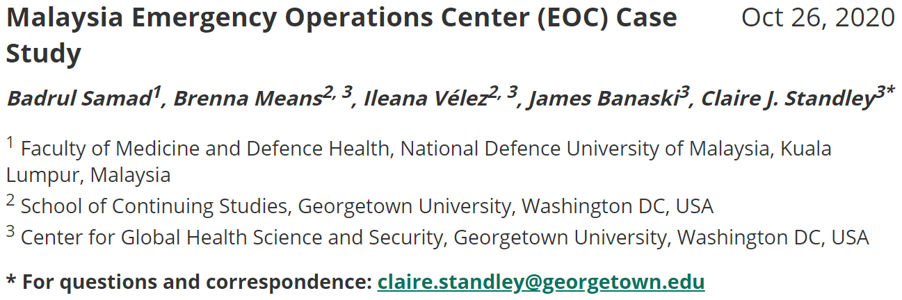



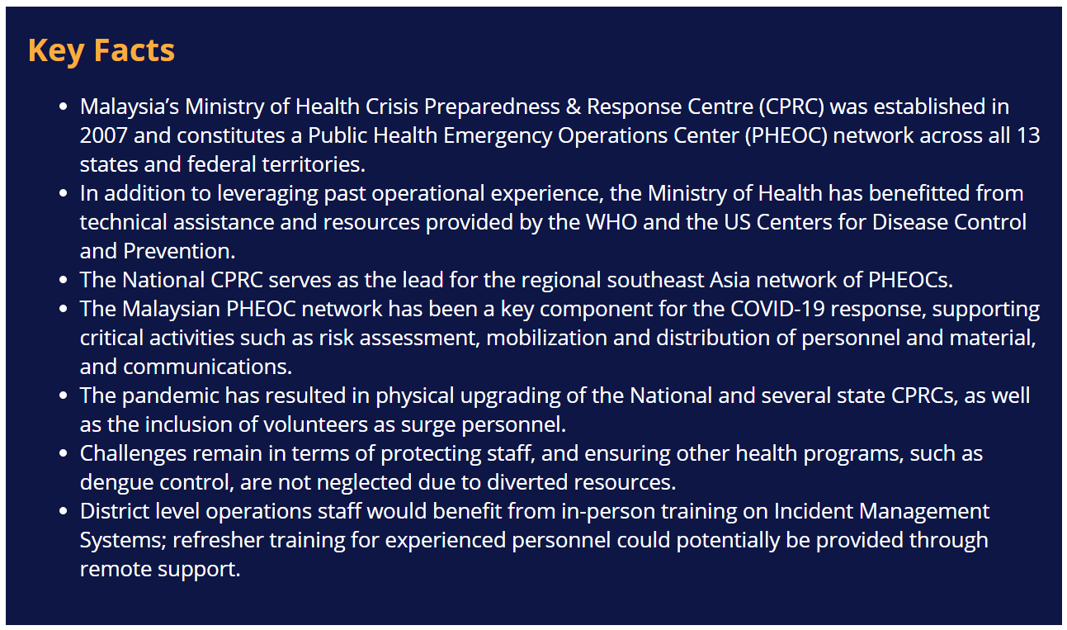
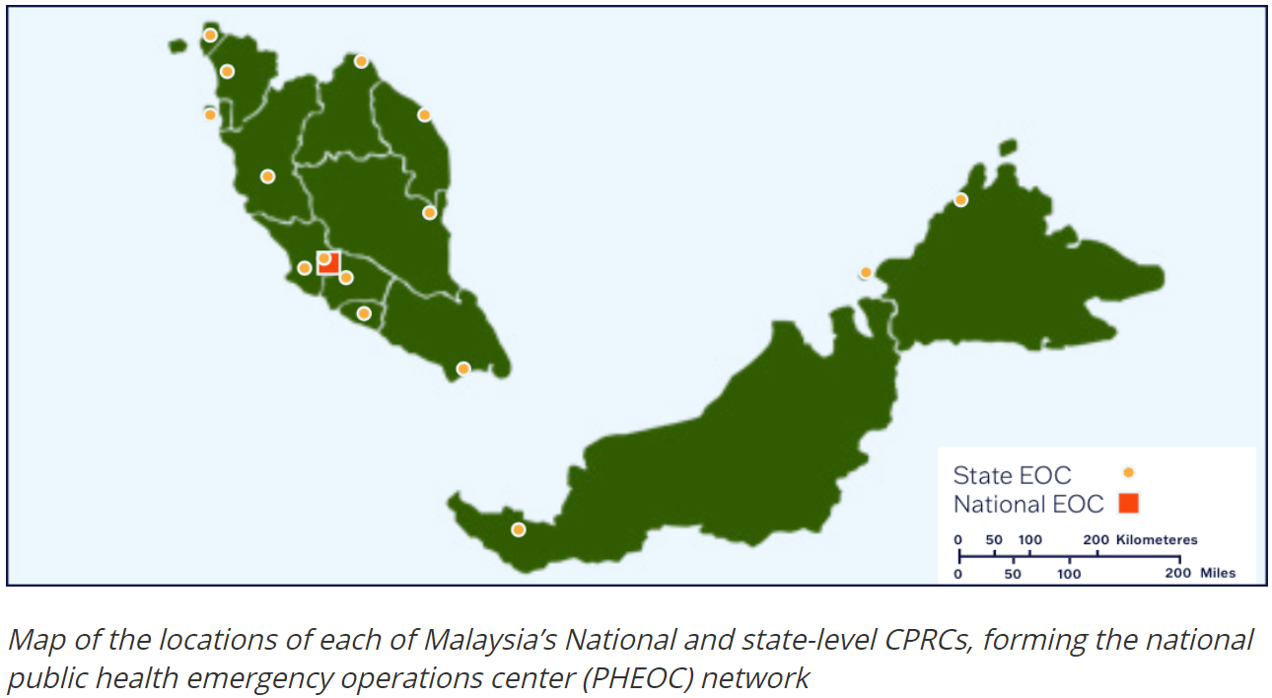
Epidemic EM Case Study: undefined (epidemic-em.org)

Slide 13
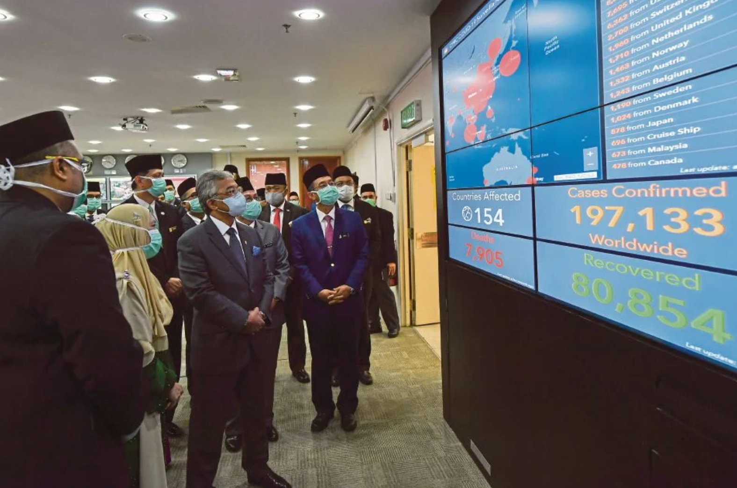
The Malaysian King visited MOH’s Crisis Preparedness & Response Centre (CPRC) in Putrajaya on 18 March 2020

Slide 14
Thank You
badrulhisham@upnm.edu.my ;
drbadrul@gmail.com

