Slide 1


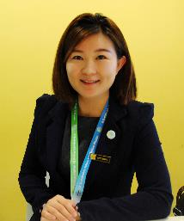

Community Support During COVID-19 Pandemic
Chai Hong Yeong, PhD, MIPM
Associate Professor
School of Medicine
Taylor’s University
Chaihong.Yeong@taylors.edu.my

Slide 2
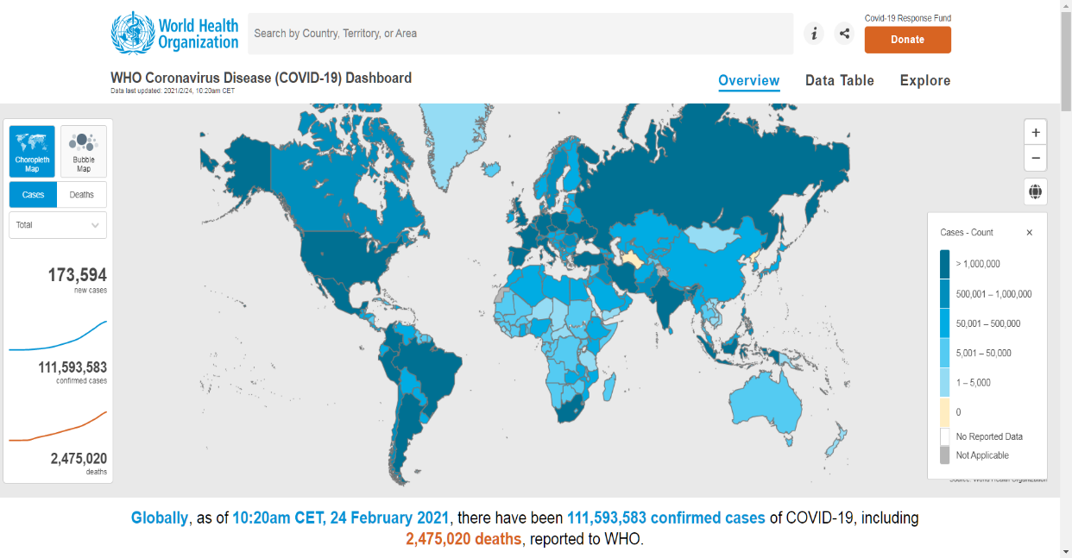
https://covid19.who.int/

Slide 3


HOW BAD IS 2.5 MILLION?
1.79 mil
5.7 mil
SINGAPORE

Slide 4
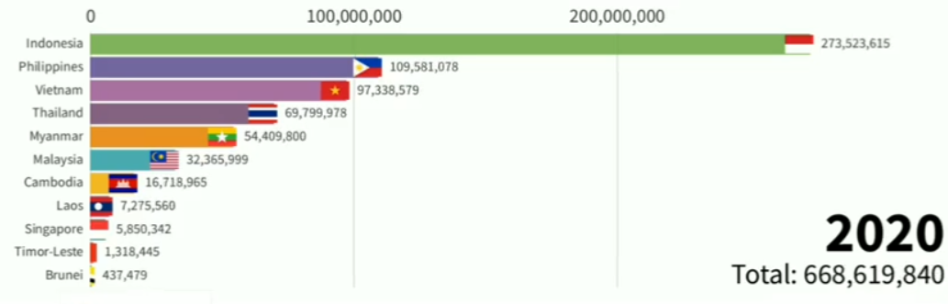
HOW BAD IS 111 MILLION?

Slide 5
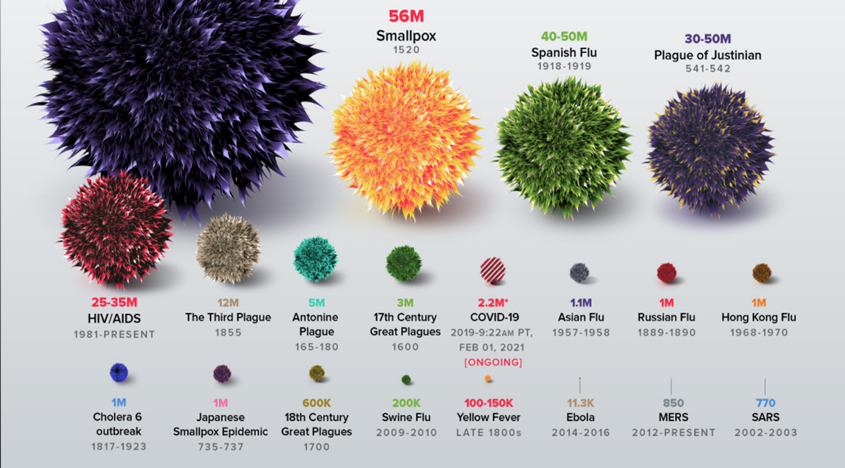

Slide 6
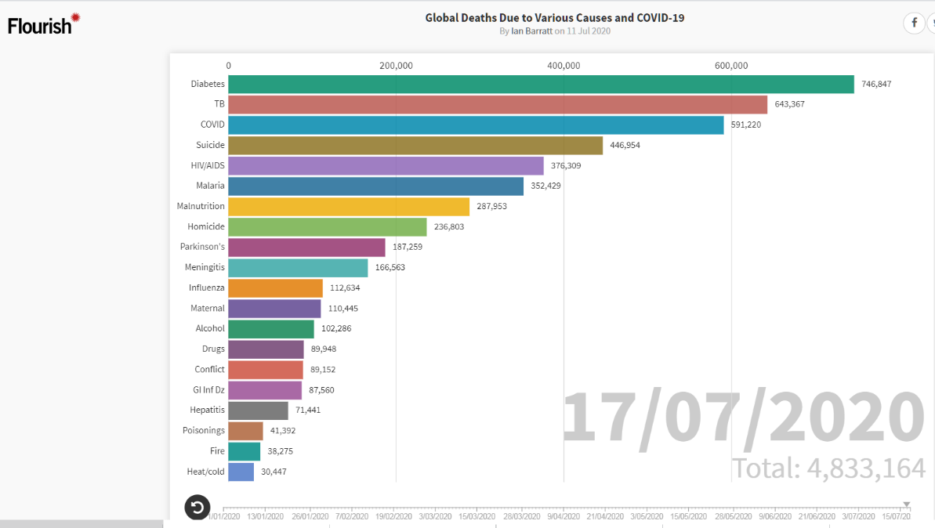
3rd Global Killer in just 6 months!!

Slide 7
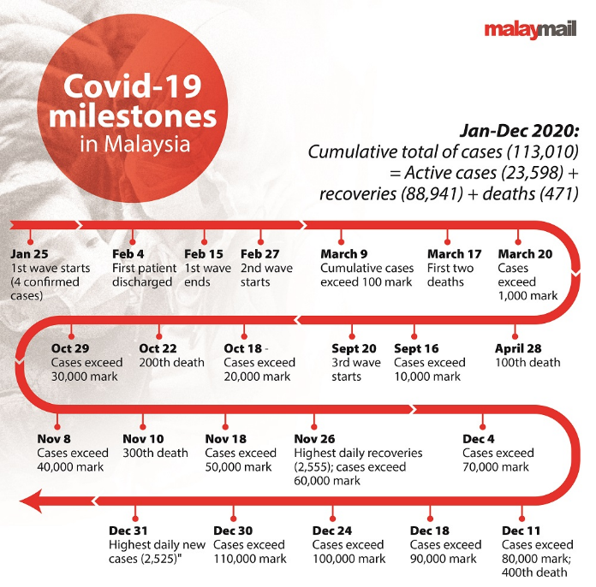
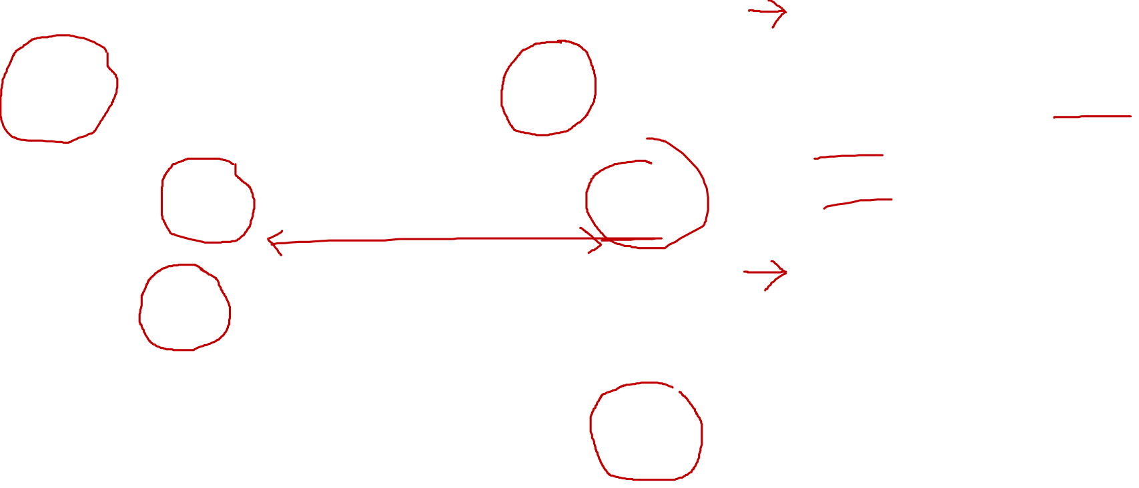
Malaysia Scenario
MCO 1.0 | 18 -31 Mar 20
MCO 1.2 | 1 – 14 Apr 20
MCO 1.3 | 15 Apr – 3 May 20
CMCO | 4 May – 9 Jun 20
RMCO | 10 Jun – 12 Jan 21
MCO 2.0 | 13 Jan – 26 Jan 21
MCO 2.1 | 27 Jan – 4 Feb 21
MCO 2.2 | 5 Feb – 18 Feb 21
MCO 2.2 | 19 Feb – 4 Mar

Slide 8
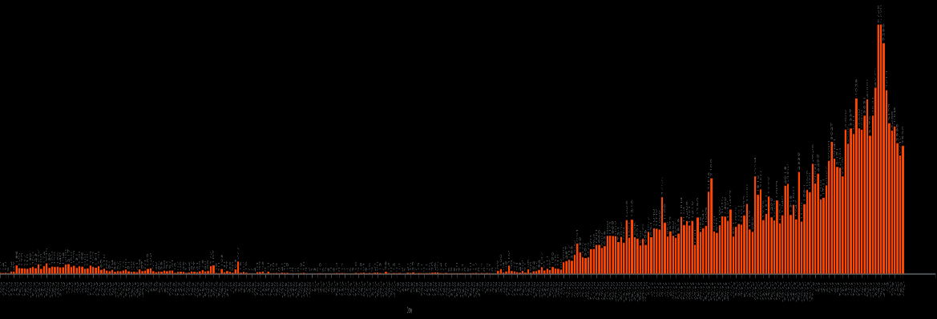

Malaysia – Daily New Cases
MCO 1.0
MCO 2.0
Mar 2020
Jan 2021

Slide 9
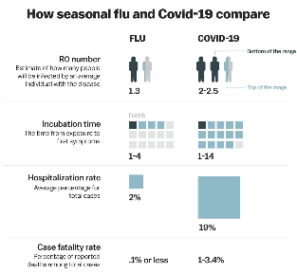
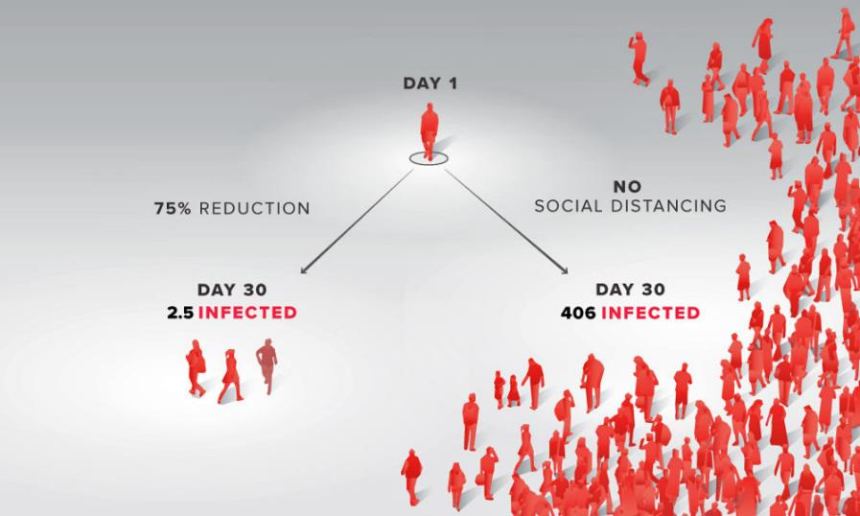

Physical Social Distancing
The MATH behind Social Distancing

Slide 10
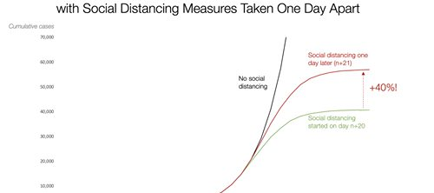

We Must Act Now (15 March 2020)

Slide 11

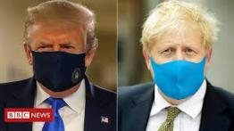
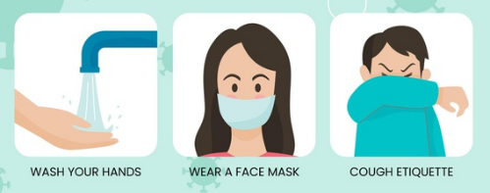



Slide 12


Slide 13
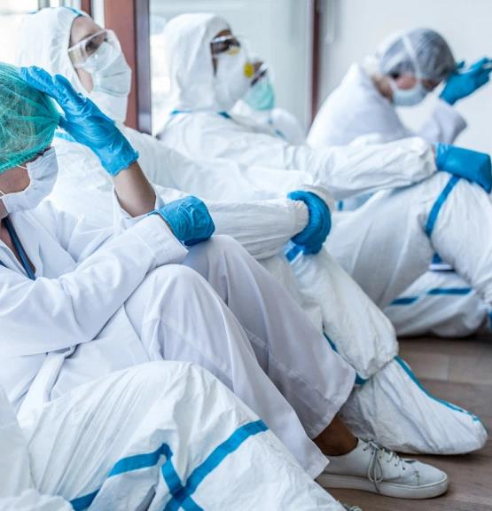
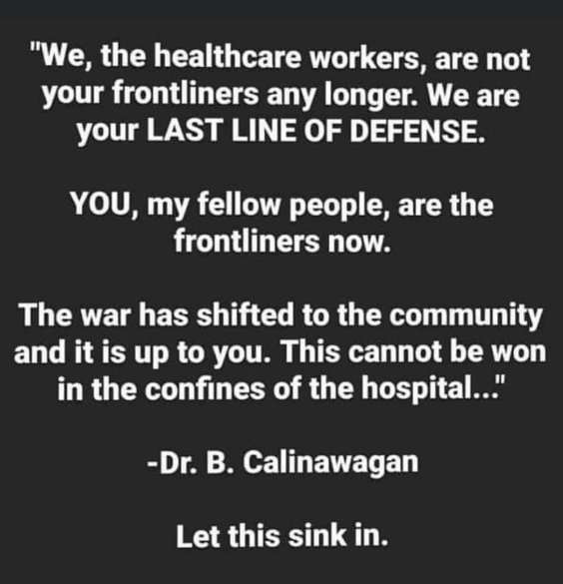


Slide 14
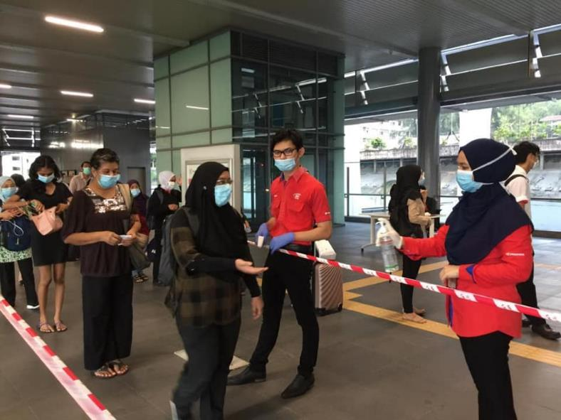
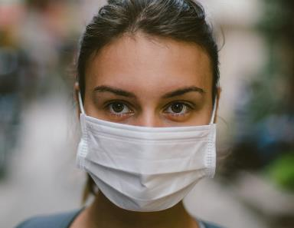
WE ARE ALL
FRONTLINERS NOW

Slide 15
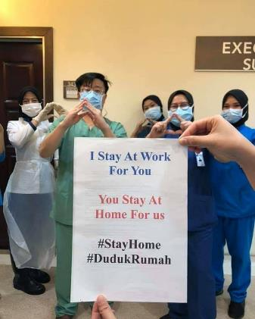


How We Can Help?

Slide 16
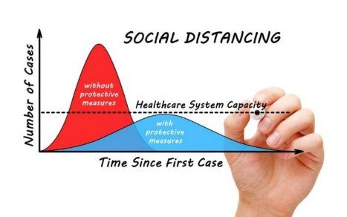


What We Can Do?
Fda.gov

Slide 17
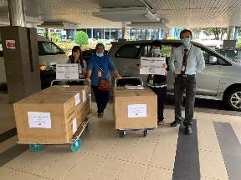
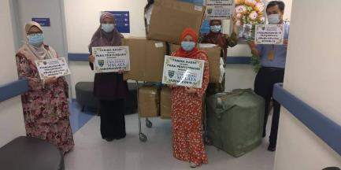
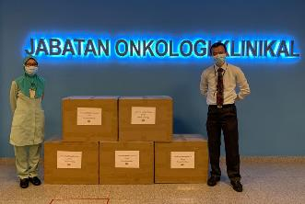
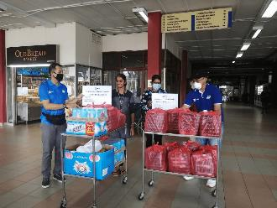

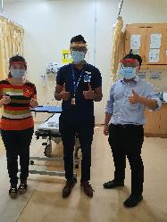
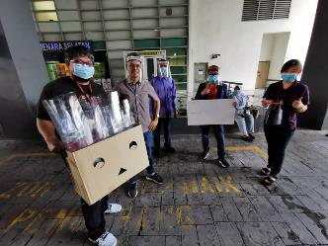
At Community Level

Slide 18
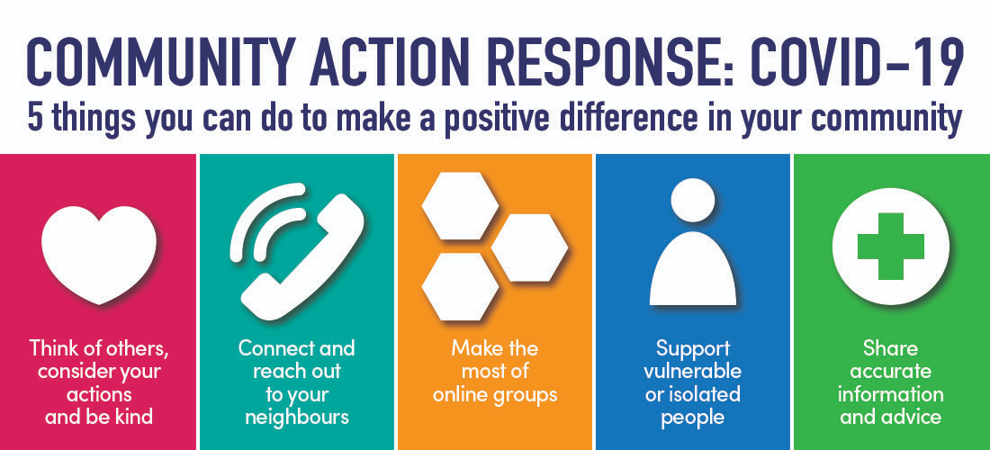

We can donate money, donate blood, donate food…… and donate LOVE

Slide 19
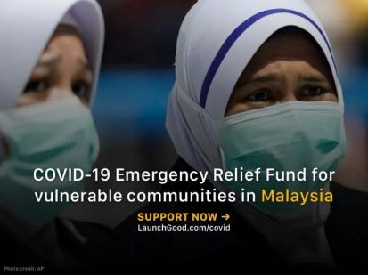

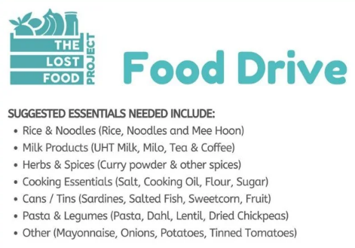
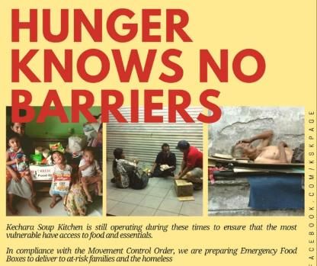

SimplyGiving programme
Notes:
Mercy Malaysia has set up a fund on LaunchGood. Since there are multi-stakeholders requesting for support and assistance, the funds will be used to assist the following beneficiaries:
​vulnerable communities who are affected by COVID-19 i.e. the refugees, elderly citizens, low-income families, immobile and underprivileged communities.
Malaysian healthcare system i.e. the hospitals, Klinik Kesihatan and the frontline staffs who are working 24 hours 7 days a week.
A crowdfunding campaign organised by Priyaa Simmi, the #KitaBantuKita initiative is targeting 500 families in need to cover RM100 of household expenses for each family. Listed on KitaFund is 4 NGOs who are in partnership with the campaign to help drive this effort.
The Kechara Soup Kitchen will be operating as usual to ensure that the most vulnerable still have access to food and basic necessities. During the MCO period, they will be delivering Emergency Food Boxes to at-risk families and the homeless.
You can help by:
(a) making a donation
(b) contributing to food items
(c) teaming up for corporate sponsorship
The Lost Food Project (TLFP) is doing a food drive to drop off essential food items for several charities, foundations, and beneficiaries. Malaysians can help by (a) donating and dropping off food items or (b) make a monetary donation. More information can be found on the SimplyGiving campaign page for TLFP.

Slide 20

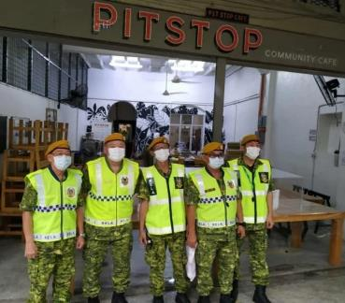

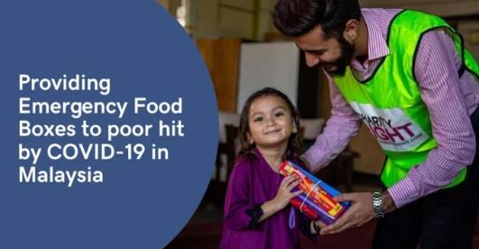
Notes:
A community effort during the Covid-19 crisis, Malaysians can offer their help by checking in and making sure the elderly group in their neighbourhood are safe and not neglected. Connect with your local community - find out how you can contribute by joining the Caremongering Malaysia Facebook group.
Pit Stop Community Cafe is accepting support in terms of donations of food items, non-food supplies (sanitisers, face masks, handwashing liquids, etc), and funds to help out to the needy. They are a community cafe in Kuala Lumpur who has been working to find solutions to urban hunger and poverty by marshalling volunteers and repurposing food.
GlobalSadaqah’s Charity Partner, Charity Right Malaysia, along with other community humanitarian partners, will be supporting affected families including healthcare workers by providing food boxes that contain essential food supplies. Each food box can feed up to 4 family members.

Slide 21


Notes:
United Nation Sustainable Development Goals
Rumah Kita is a temporary transit home which houses single expectant mothers, providing them with shelter, medical aid and nutrition from third trimester until post-confinement. They are seeking help to replenish selected food items and basic neccessities for the 20+ single mums and some older babies.
The charity run by locals is helping the needy in Penang that require assistance especially during this Covid-19 pandemic. Malaysians can help by offering monetary support or even volunteer services by getting and delivery groceries, performing admin duties, or other means of help you’re willing to contribute.

Slide 22
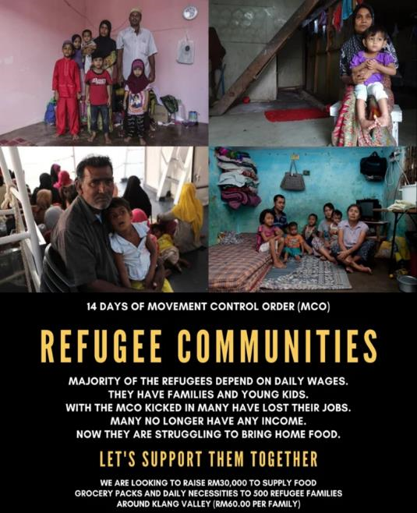
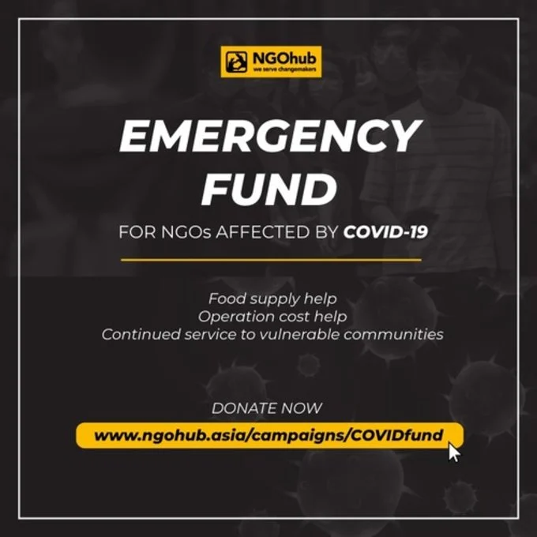
NGOs Need help too
Notes:
Refuge For The Refugees alongside Tenaganita Dapur Jalanan Kuala Lumpur and Liga Rakyat Demokratik will be joining hands to raise funds to support hundreds of refugee families. They are looking to supply food grocery packs and basic necessities for those families in dire need of help.
With the ongoing COVID-19 pandemic and the resulting Movement Control Order (MCO), many homegrown NGOs are struggling to manage the impacts of the situation on their daily operations. NGOhub’s campaign aims to provide much-needed emergency funding to NGOs (a total of 16 beneficiaries) who continue to serve our most vulnerable communities such as the homeless, elderly, orphans, disabled persons, and refugees.

Slide 23
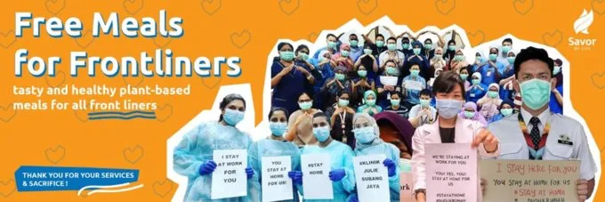


Say THANK YOU
Notes:
Savor of Life is calling for Malaysians to contribute to their campaign to deliver nutritious food to the medical frontliners at Hospitals KL and Sungai Buloh. Each day, meals are delivered to the 2 locations to doctors, nurses, and other medical professionals on duty.

Slide 24
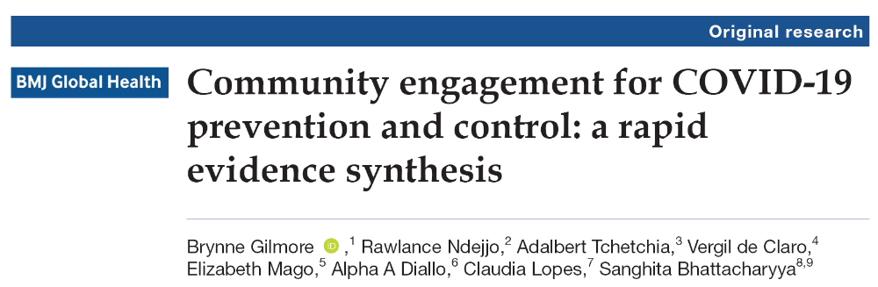

Previous pandemic experience highlights how communities can play important and active roles in prevention and control of a pandemic. Countries worldwide are encouraged to assess existing community engagement structures and use community engagement approaches to support contextually specific, acceptable and appropriate COVID-19 prevention and control measures.

Slide 25

https://mereka.my/protecting-our-frontliners/

Slide 26
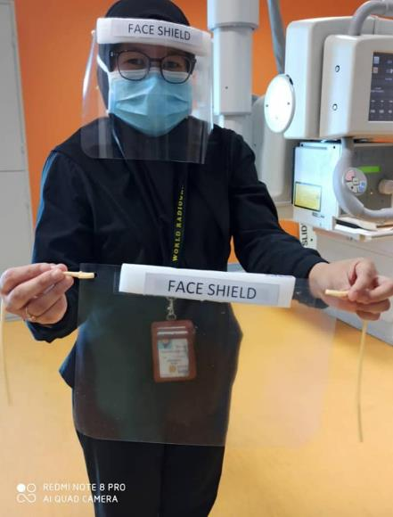
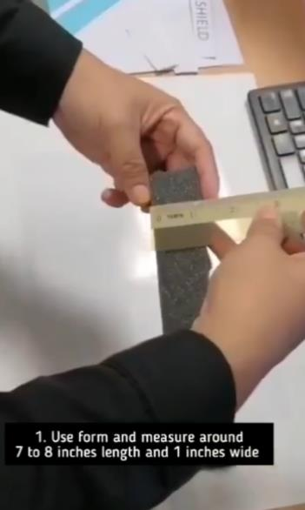
At Technical Level

Slide 27
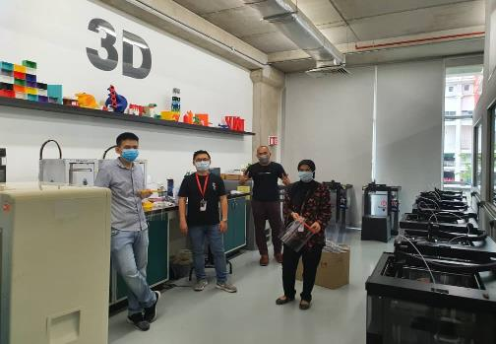
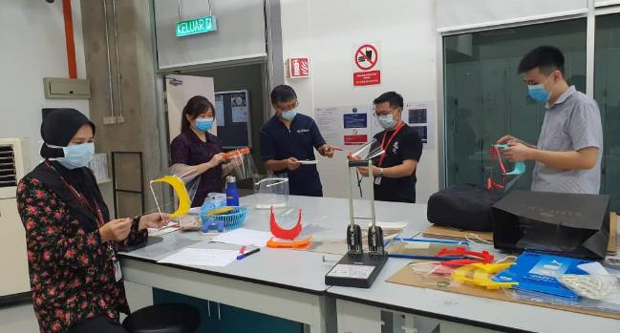
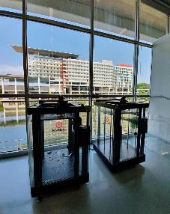
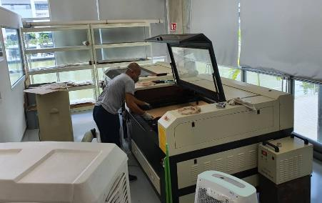
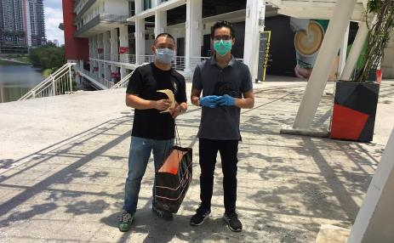
How Research and Innovation Helps the Fight…
Our volunteers team – Dr Wong, Dr Choo, Mr Ahmad, Dr Anis, led by AP Dr Yeong
PVC showing mental support
Unsung heroes: 3D Printers
Laser cutting machine
Mechanical Engineering Student

Slide 28
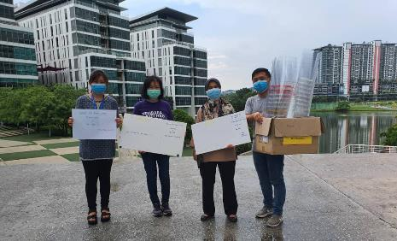
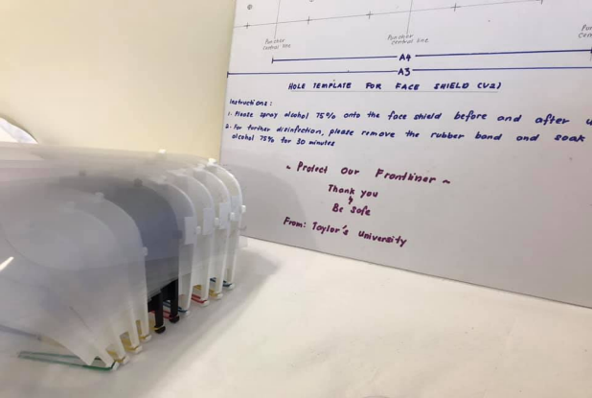
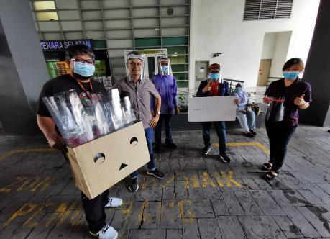
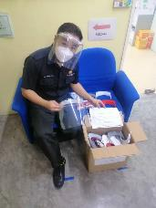
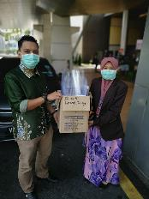
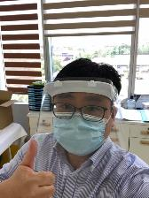

Slide 29
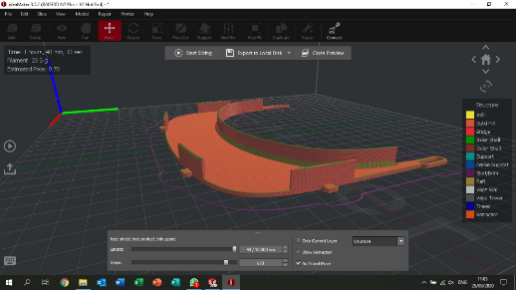
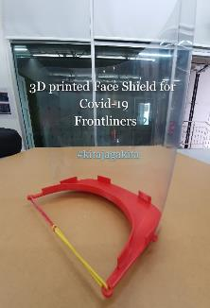

Our design:
Fast production time (40 min per face shield, 15 min per mask strap)
Can be disinfected using >75% alcohol, reusable
Easily replaced plastic protector
Designed for healthcare professionals (full top coverage)
Lightweight
Minimal consumables (rubber band, A4 plastic sheet, hole puncher)
Biodegradable material (PLA)

Slide 30




First Version
Second Version

Slide 31




“Ear Saver”
“Covid-19 Hijab Accessory”

Slide 32







#Protect_Frontliners
#KitaJagaKita

Slide 33





Slide 34









https://mereka.my/protecting-our-frontliners/
(USD 30k)

Slide 35



The Power of Love

Slide 36


sauna32 IoT Thermometer
Notes:
The IR thermometer is integrated with GPS location and connected to an AI (artificial intelligence) system, where we will use the Internet-of-thing (IOT) technology to track the hot spot in the country so that early action can be taken to prevent the outbreak

Slide 37

sauna32 IoT Thermometer
Notes:
The IR thermometer is integrated with GPS location and connected to an AI (artificial intelligence) system, where we will use the Internet-of-thing (IOT) technology to track the hot spot in the country so that early action can be taken to prevent the outbreak

Slide 38










Slide 39





Prof Dr John Cameron, Wisconsin
Prof Dr Ng Kwan Hoong, Malaysia
Recipient of 2020 Merdeka Award

Slide 40



www.covid19bibliometrics.org
A collaboration with Elsevier Scopus

Slide 41


How Can We Overcome the Pandemic?

Slide 42


CRISIS

Slide 43



Slide 44


This portrait is made with the pics of all the doctors and nurses who passed away in the pandemic 🙏🙏
Notes:
This potrait is made with the pics of all the doctors and nurses who passed away in the pandemic. 🙏🏻🙏🏻Enlarge and see. It's very difficult to be a doctor, very easy to criticize. Happy Doctors day to all who gave there life for mankind and those who are still working day and night

